Slide 2
Chapter 2
Research in Psychology

Slide 3
Thinking Critically About Psychology (or Anything Else!)
What am I being asked to believe or accept?
What evidence is available to support the assertion?
Are there alternative ways of interpreting the evidence?
What additional evidence would help to evaluate the alternatives?
What conclusions are most reasonable?

Slide 4
Critical Thinking and Scientific Research
Scientific research often begins with one’s curiosity.
Important Terms
Hypothesis
Operational definition
Variable
Data
Reliability
Validity

Slide 5
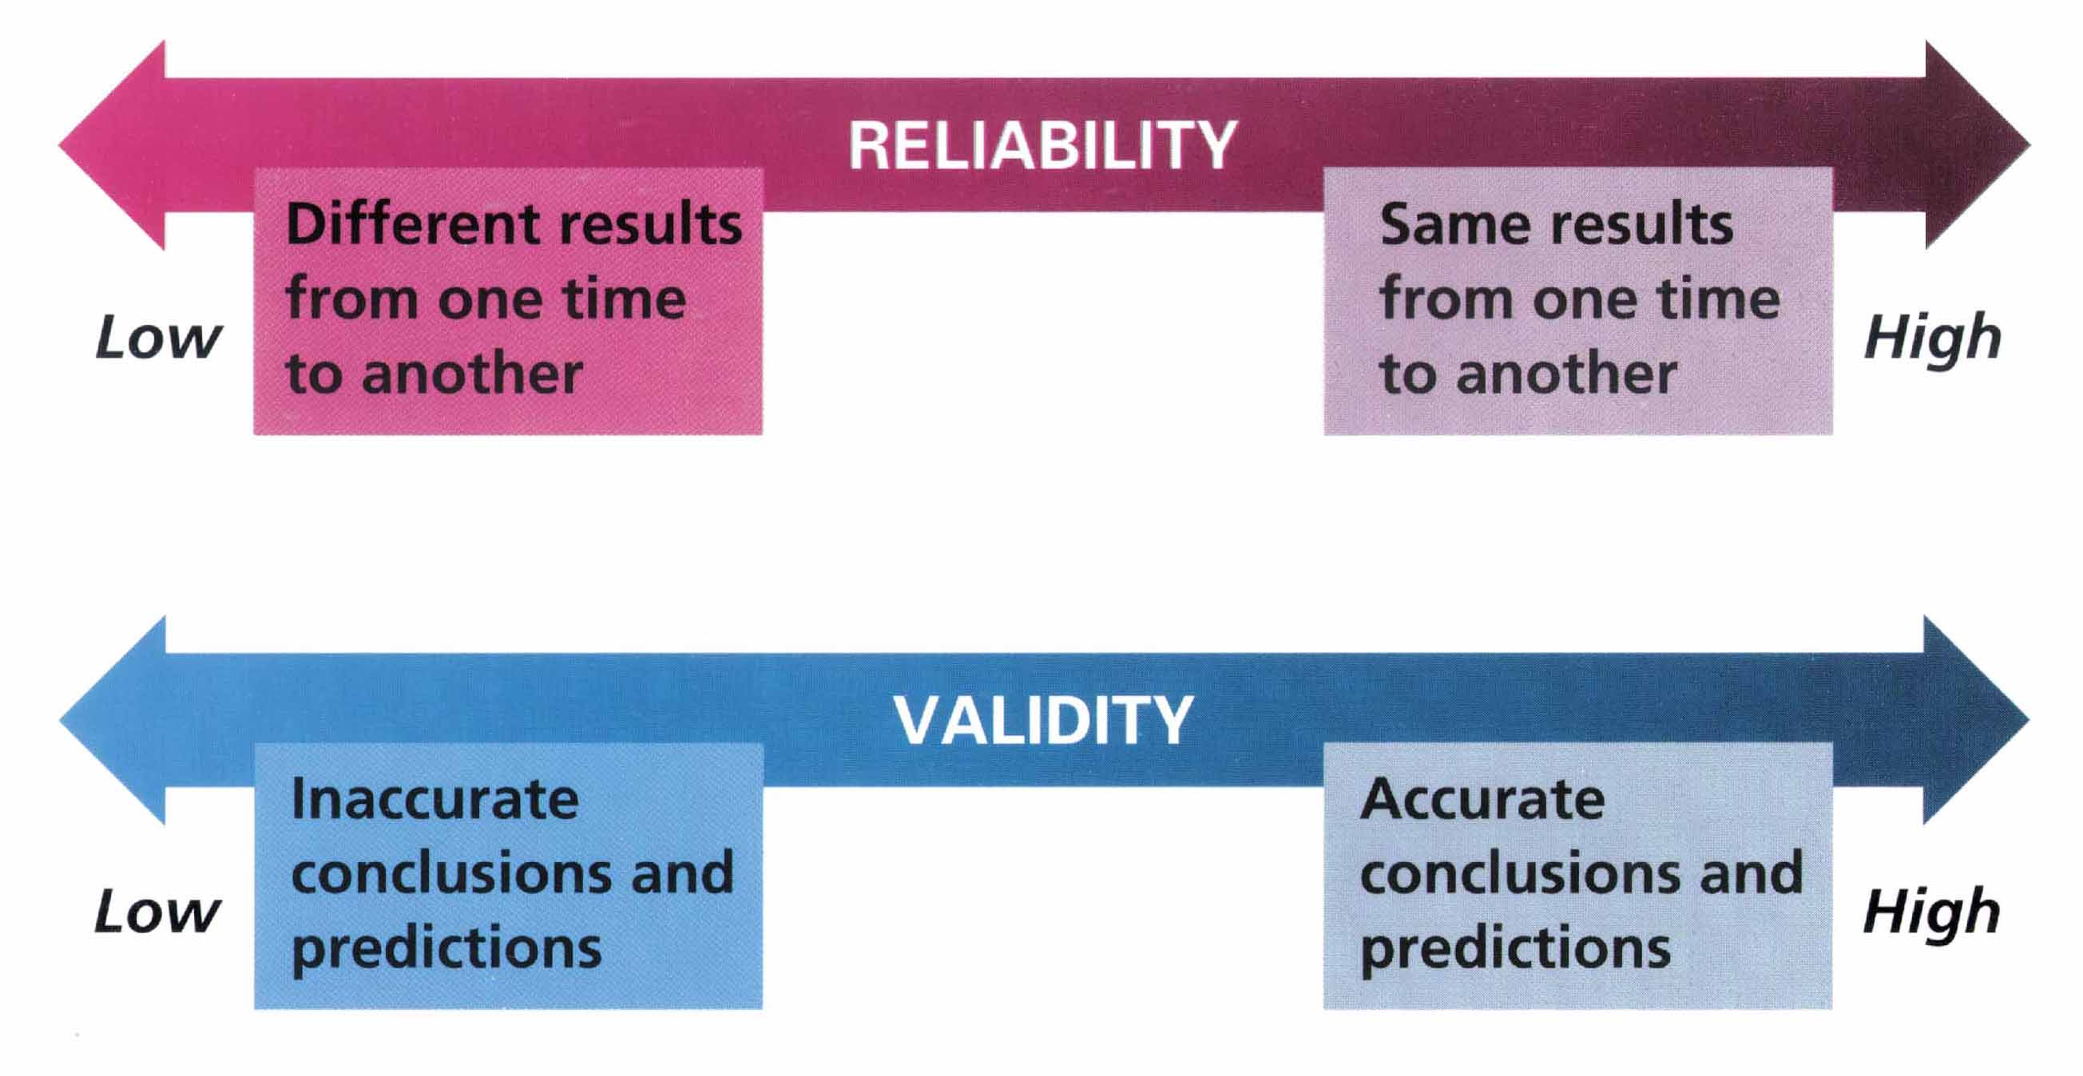
Reliability and Validity
Zick Rubin, Lelitia Anne Peplau, and Peter Salovey, Psychology. Copyright © 1993 by Houghton Mifflin Company. Reprinted by permission

Slide 6
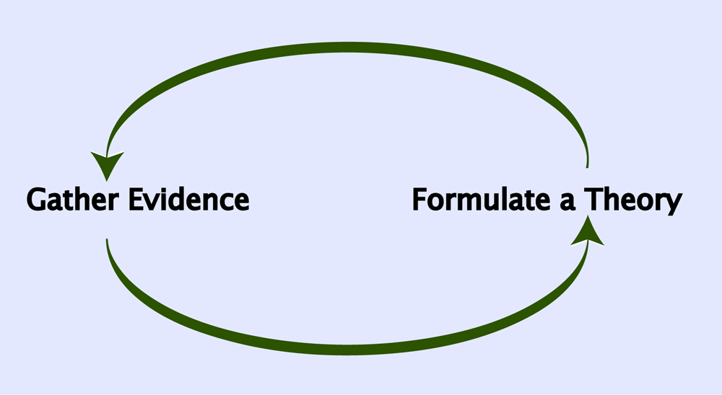
The Scientific Method

Slide 7
Goals of Psychological Research
To describe
To make accurate predictions
To demonstrate some control
To explain

Slide 8
Naturalistic Observations
Features: Observations of human or animal behavior in the environment in which it typically occurs
Strengths: Provides descriptive data about behavior presumably uncontaminated by outside influences
Pitfalls: Observer bias and participant self-consciousness can distort results

Slide 9
Case Studies
Features: Intensive examination of the behavior and mental processes associated with a specific person or situation
Strengths: Provide detailed descriptive analysis of new, complex, or rare phenomenon
Pitfalls: May not provide representative picture of phenomena

Slide 10
Surveys
Features: Standard set of questions asked of a large number of participants
Strengths: Gather large amounts of descriptive data relatively quickly and inexpensively
Pitfalls: Sampling errors, poorly phrased questions, and response biases can distort results

Slide 11
Correlational Studies
Features: Examine the relationships between research variables
Strengths: Can test predictions, evaluate theories, and suggest new hypotheses
Pitfalls: Cannot infer causal relationships between variables

Slide 12
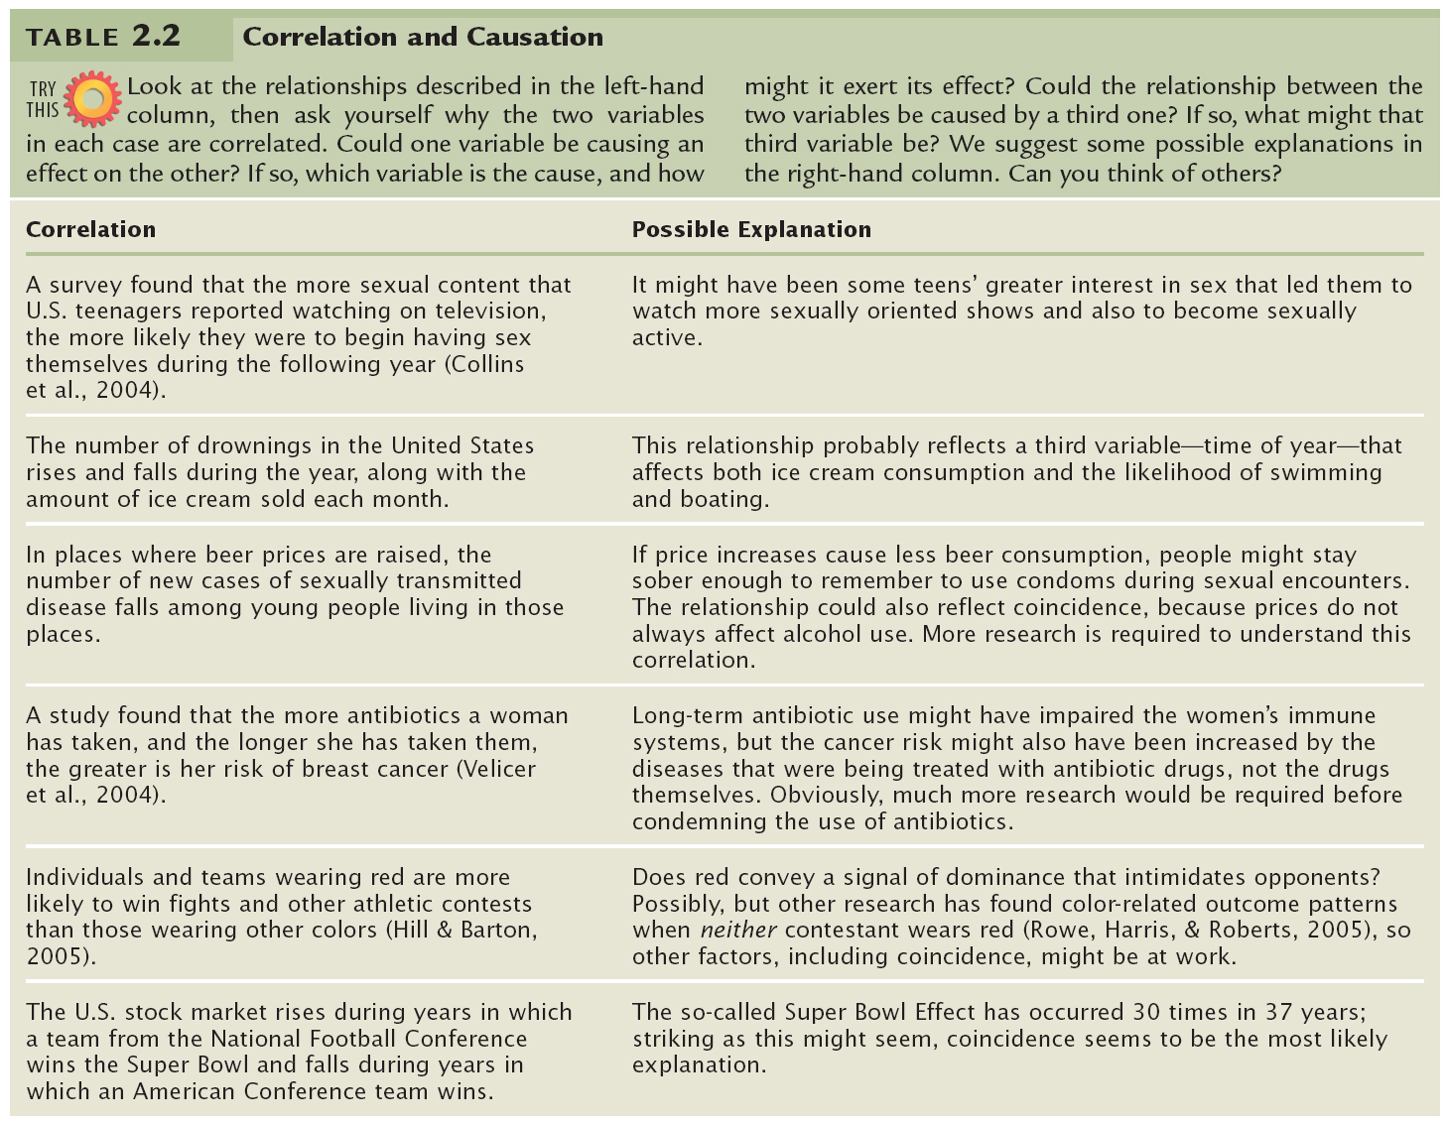

Slide 13
Experiments
Features: Manipulation of an independent variable and measurement of its effects on a dependent variable
Strengths: Can establish a cause-effect relationship between independent and dependent variables
Pitfalls: Confounding variables may prevent valid conclusions

Slide 14
Figure 2.1: A Simple Two-Group Experiment
Independent Variable: Whether or not one received the EMDR treatment
Dependent Variable: Anxiety level

Slide 15
Sources for Confounding Variables
Random Variables
Importance of random assignment
Participants’ Expectations
Placebo effect
Experimenter Bias
Often minimized through the use of a double-blind design

Slide 16
Chapter 2
Research in Psychology

Slide 17
Thinking Critically About Psychology (or Anything Else!)
What am I being asked to believe or accept?
What evidence is available to support the assertion?
Are there alternative ways of interpreting the evidence?
What additional evidence would help to evaluate the alternatives?
What conclusions are most reasonable?

Slide 18
Critical Thinking and Scientific Research
Scientific research often begins with one’s curiosity.
Important Terms
Hypothesis
Operational definition
Variable
Data
Reliability
Validity

Slide 19
Reliability and Validity
Zick Rubin, Lelitia Anne Peplau, and Peter Salovey, Psychology. Copyright © 1993 by Houghton Mifflin Company. Reprinted by permission

Slide 20
The Scientific Method

Slide 21
Goals of Psychological Research
To describe
To make accurate predictions
To demonstrate some control
To explain

Slide 22
Naturalistic Observations
Features: Observations of human or animal behavior in the environment in which it typically occurs
Strengths: Provides descriptive data about behavior presumably uncontaminated by outside influences
Pitfalls: Observer bias and participant self-consciousness can distort results

Slide 23
Case Studies
Features: Intensive examination of the behavior and mental processes associated with a specific person or situation
Strengths: Provide detailed descriptive analysis of new, complex, or rare phenomenon
Pitfalls: May not provide representative picture of phenomena

Slide 24
Surveys
Features: Standard set of questions asked of a large number of participants
Strengths: Gather large amounts of descriptive data relatively quickly and inexpensively
Pitfalls: Sampling errors, poorly phrased questions, and response biases can distort results

Slide 25
Correlational Studies
Features: Examine the relationships between research variables
Strengths: Can test predictions, evaluate theories, and suggest new hypotheses
Pitfalls: Cannot infer causal relationships between variables

Slide 27
Experiments
Features: Manipulation of an independent variable and measurement of its effects on a dependent variable
Strengths: Can establish a cause-effect relationship between independent and dependent variables
Pitfalls: Confounding variables may prevent valid conclusions

Slide 28
Figure 2.1: A Simple Two-Group Experiment
Independent Variable: Whether or not one received the EMDR treatment
Dependent Variable: Anxiety level

Slide 29
Sources for Confounding Variables
Random Variables
Importance of random assignment
Participants’ Expectations
Placebo effect
Experimenter Bias
Often minimized through the use of a double-blind design

