Slide 1
Research Methods Part 2

Slide 2
Experiments
Features: Manipulation of an independent variable and measurement of its effects on a dependent variable
Strengths: Can establish a cause-effect relationship between independent and dependent variables
Pitfalls: Confounding variables may prevent valid conclusions

Slide 3
Figure 2.1: A Simple Two-Group Experiment
Independent Variable: Whether or not one received the EMDR treatment
Dependent Variable: Anxiety level

Slide 4
Sources for Confounding Variables
Random Variables
Importance of random assignment
Participants’ Expectations
Placebo effect
Experimenter Bias
Often minimized through the use of a double-blind design

Slide 5
Selecting Human Participants for Research
The sampling procedures used can:
Affect the research results
Limit the meaning of the results
Representative Samples
Random Samples
not the same as random assignment!
Convenience Samples

Slide 6
Linkages: Psychological Research Methods and Behavioral Genetics
What methods can be used to study how genes and environments work together to shape behavior?
Family studies
Twin studies
Adoption studies
Continue

Slide 7
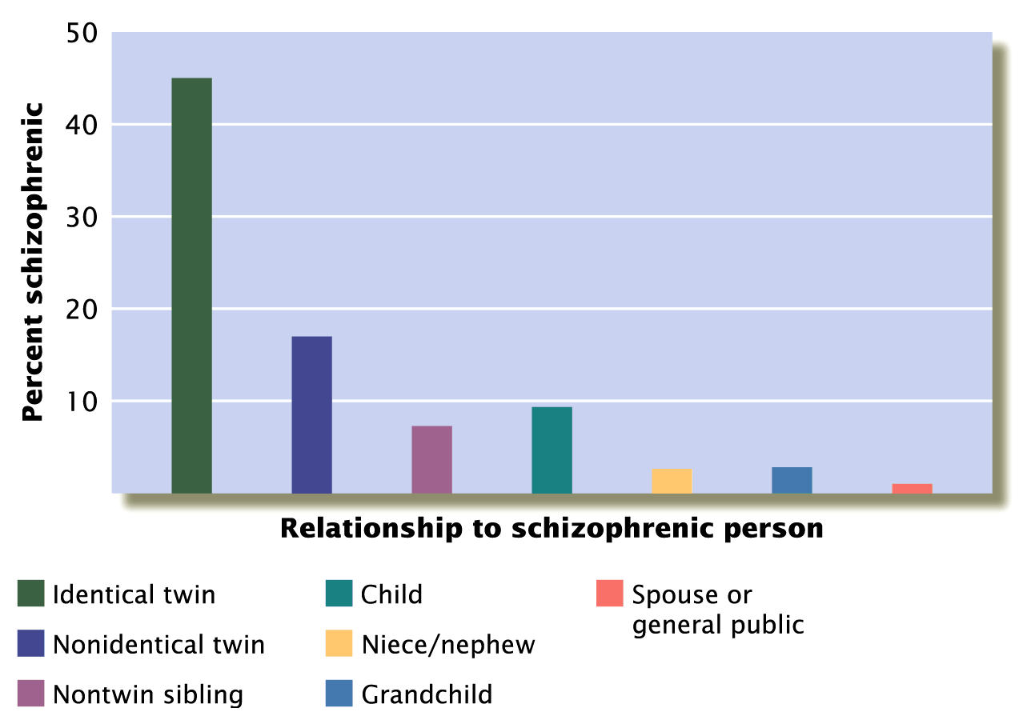
Figure 2.2: Family and Twin Studies of Schizophrenia
Return

Slide 8
Statistical Analysis of Research Results
Descriptive Statistics
Measures of central tendency
Measures of variability
Correlation coefficients
Inferential Statistics
Meaning of “statistically significant”
Continue

Slide 9
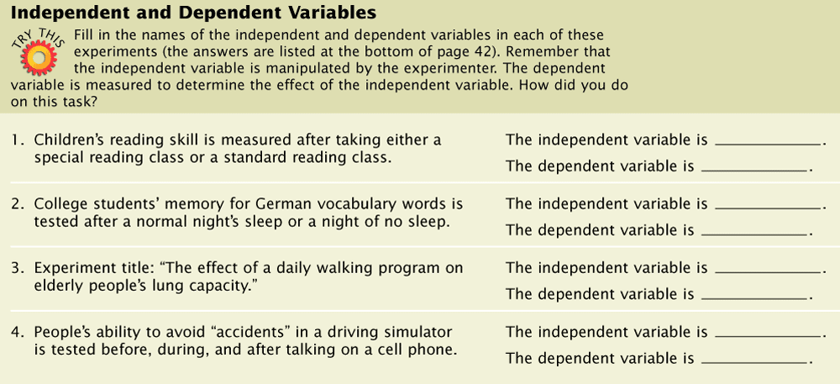
Table 2.3 Independent and Dependent Variables

Slide 10
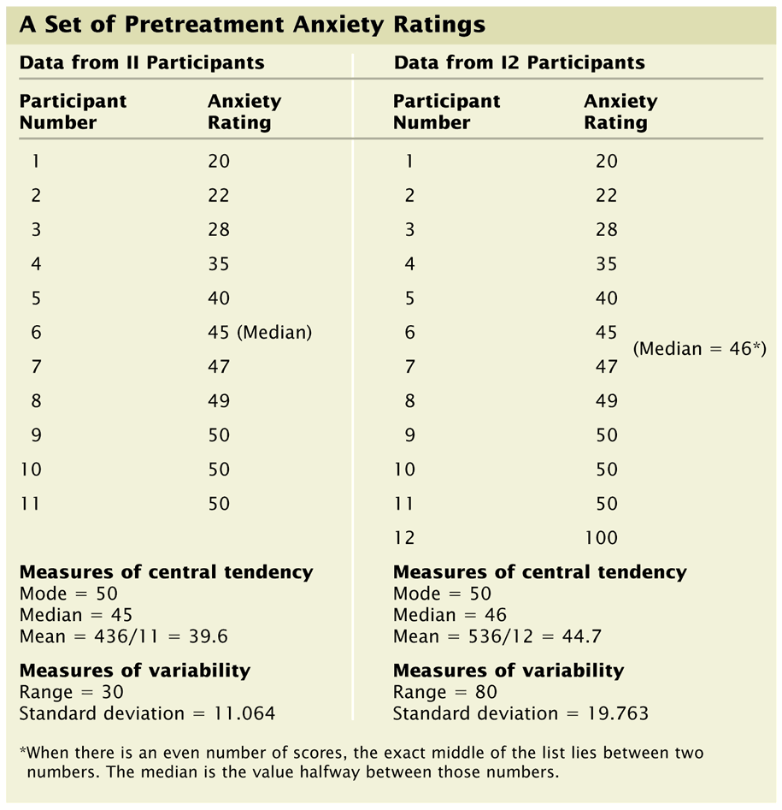
Table 2.4: A Set of Pretreatment Anxiety Ratings
Return

Slide 11
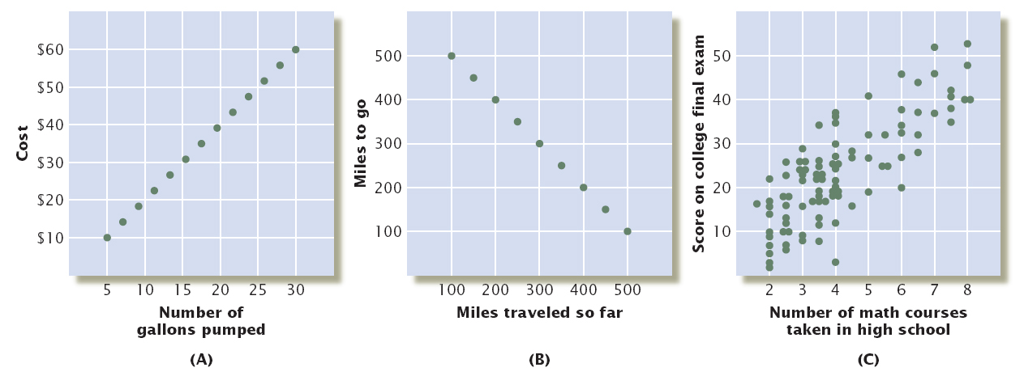
Figure 2.3: Three Correlations
Return

Slide 12
Ethical Guidelines for Psychologists
Ethical obligations when conducting research using both humans and animals
Role of the Institutional Review Board
APA’s Ethical Principles of Psychologists and Code of Conduct

Slide 13
Additional Photos/Art/Tables

