Slide 1
The Visual System: The Nature of Light
Module 9: Sensation

Slide 2
Electromagnetic Energy
An energy spectrum that includes X-rays, radar, and radio waves
A small portion of the spectrum includes light visible to the human eye

Slide 3
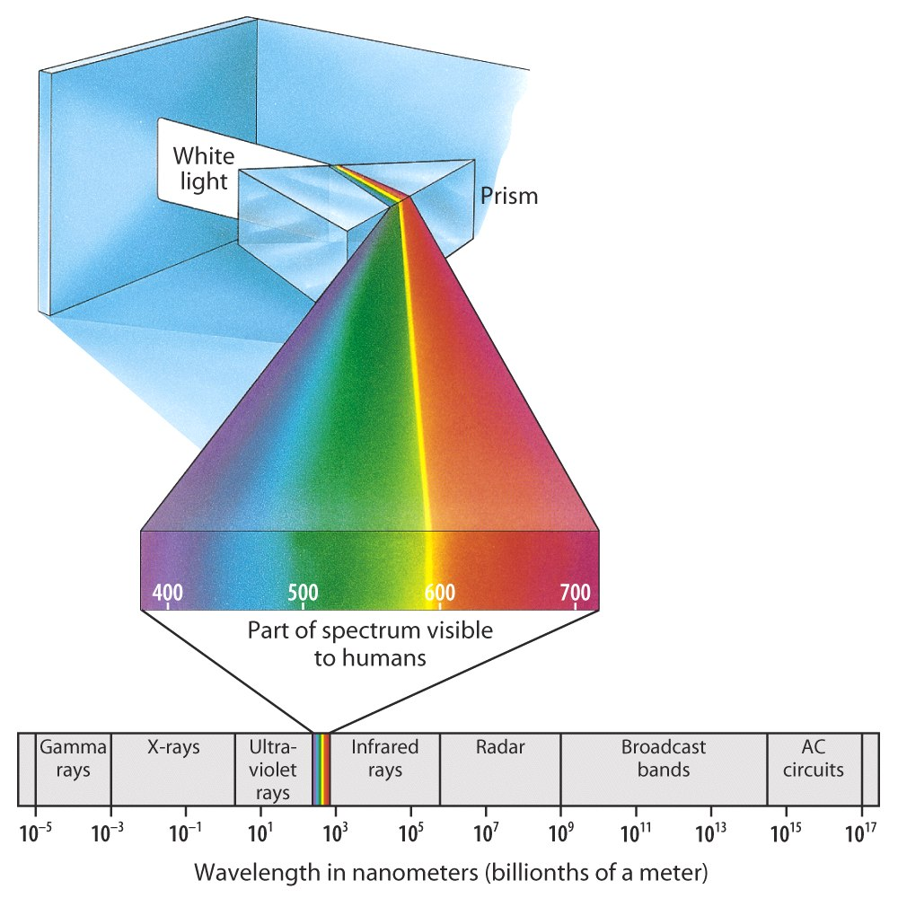
The Electromagnetic Spectrum

Slide 4
Hue
The color of light as determined by the wavelength Includes: red, orange, yellow, green, blue, indigo and violet (ROY G BIV)

Slide 5
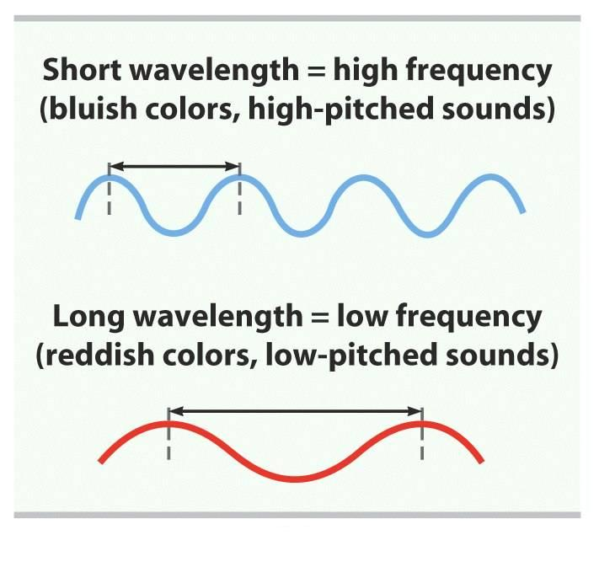
Wavelength

Slide 6
Amplitude
The brightness of light as determined by height of the wave

Slide 7
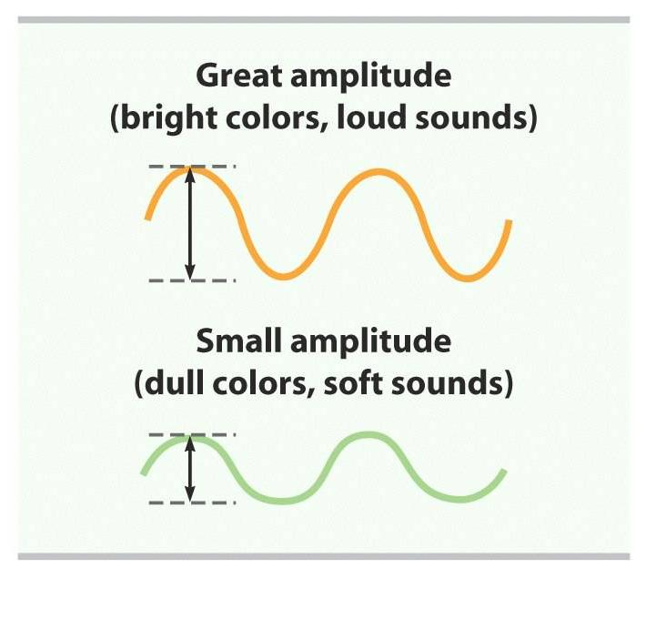
Amplitude

Slide 8
The Visual System: The Structure of the Visual System
Module 9: Sensation

Slide 9
Cornea
The clear bulge on the front of the eyeball
Begins to focus the light by bending it toward a central focal point
Protects the eye

Slide 10
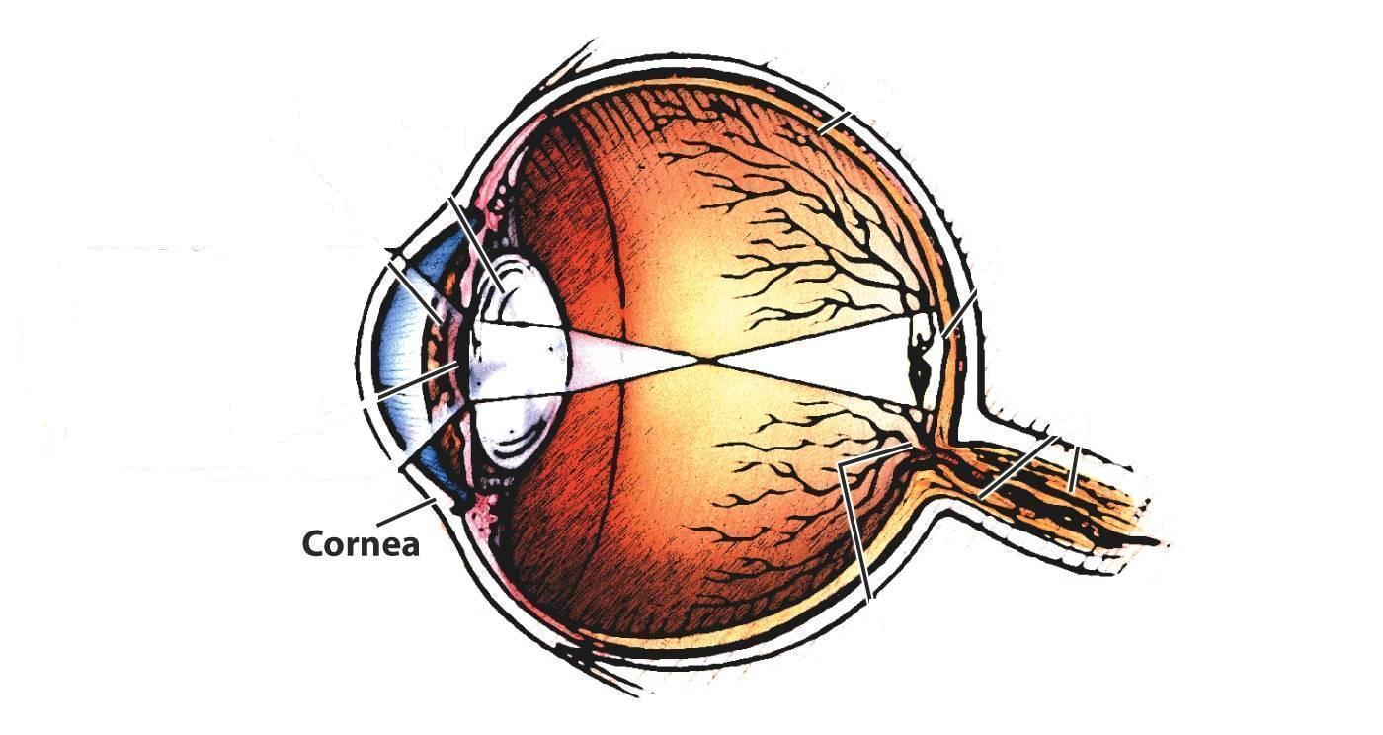
Parts of the Eye – Cornea

Slide 11
Iris
forms the colored portion of the eye; creates a hole in the center of the iris (pupil)
Regulates the size of the pupil by changing its size--allowing more or less light to enter the eye (camera demo)

Slide 12

Parts of the Eye - Iris

Slide 13
Pupil
The adjustable opening in the center of the eye that controls the amount of light entering the eye (surrounded by the iris)

Slide 14
Pupil
In bright conditions the iris expands, making the pupil smaller.
In dark conditions the iris contracts, making the pupil larger.

Slide 15
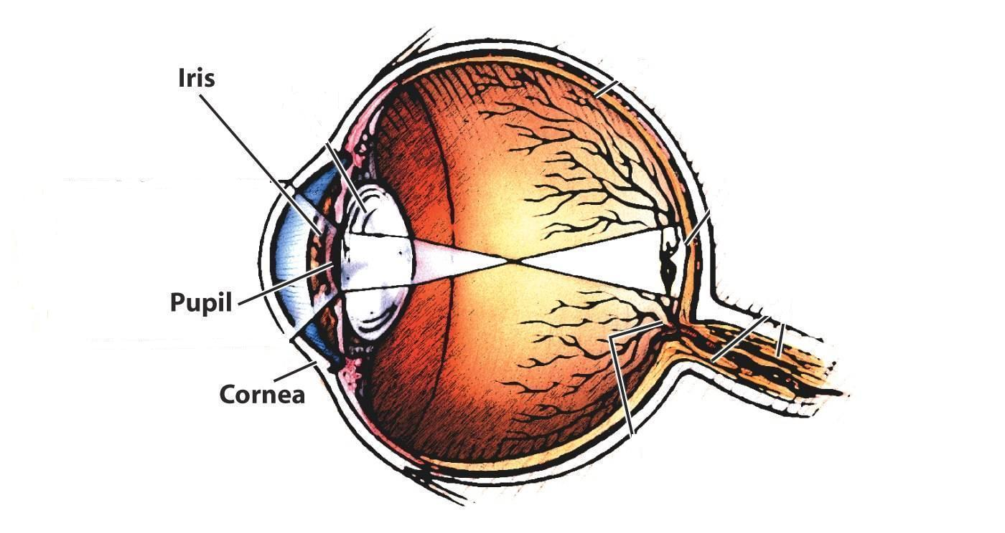
Parts of the Eye - Pupil

Slide 16
Lens
A transparent structure behind the pupil; focuses the image on the back of the eye (retina)

Slide 17
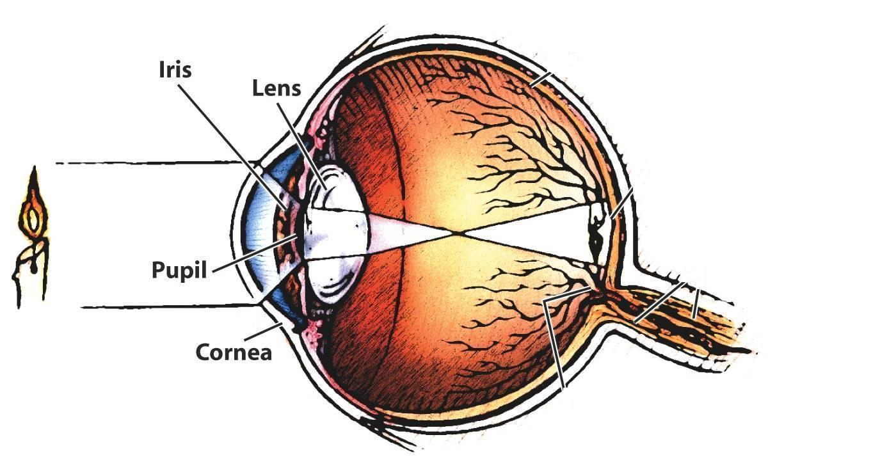
Parts of the Eye - Lens

Slide 18
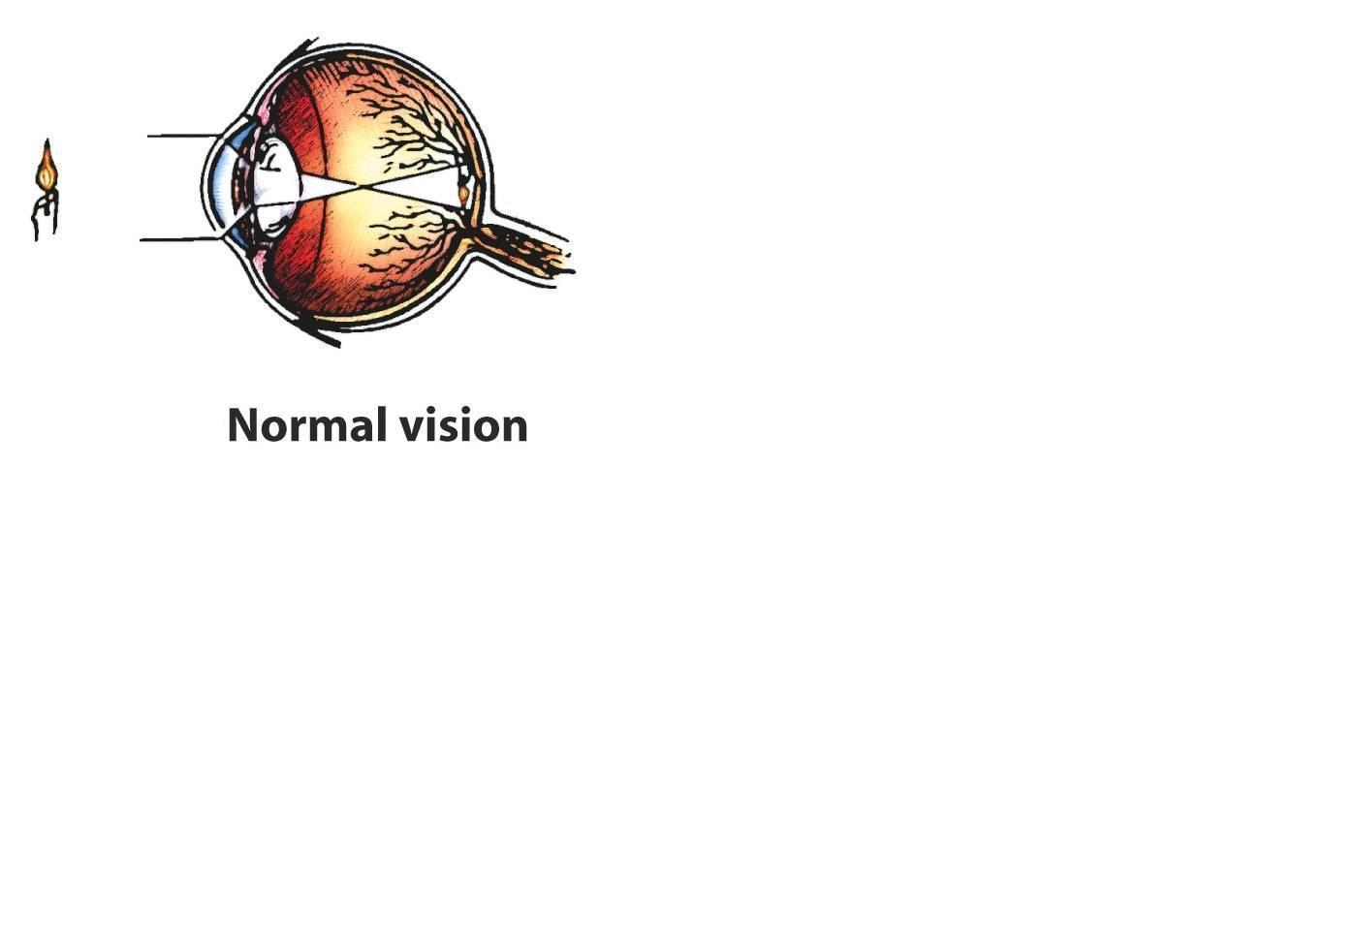

Slide 19
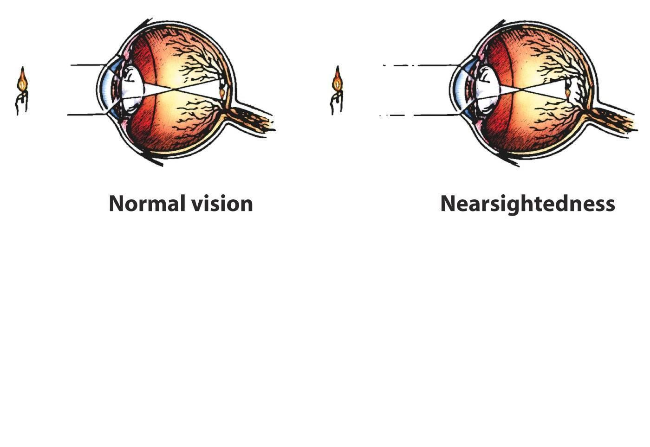

Slide 20
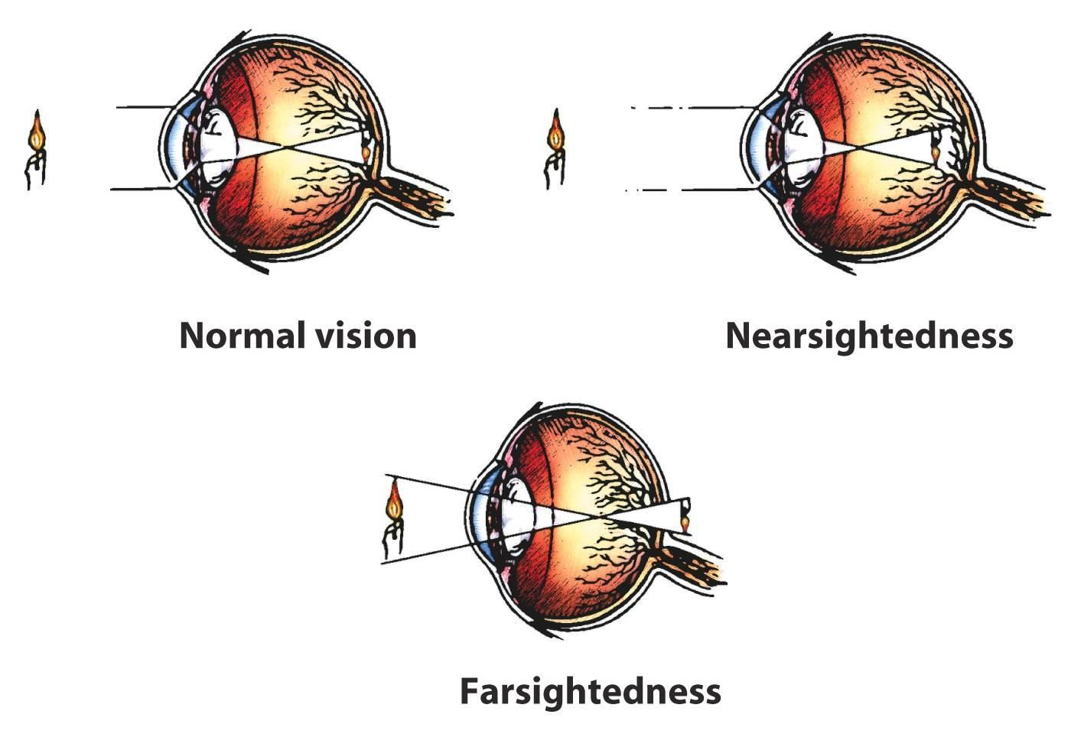

Slide 21
Retina
Light-sensitive surface with cells that convert light energy to nerve impulses
At the back of the eyeball

Slide 22
Retina
Made up of three layers of cells
  Receptor cells

Slide 23

Parts of the Eye - Retina

Slide 24
Receptor Cells
These cells are present in every sensory system to change (transduce) some other form of energy into neural impulses.
In sight they change light into neural impulses the brain can understand.
Visual system has two types of receptor cells – rods and cones

Slide 25
Rods
Visual receptor cells located in the retina
Can only detect black and white
Respond to less light than do cones

Slide 26
Cones
Visual receptor cells located in the retina
Can detect sharp images and color
Need more light than the rods
Many cones are clustered in the fovea.

Slide 27
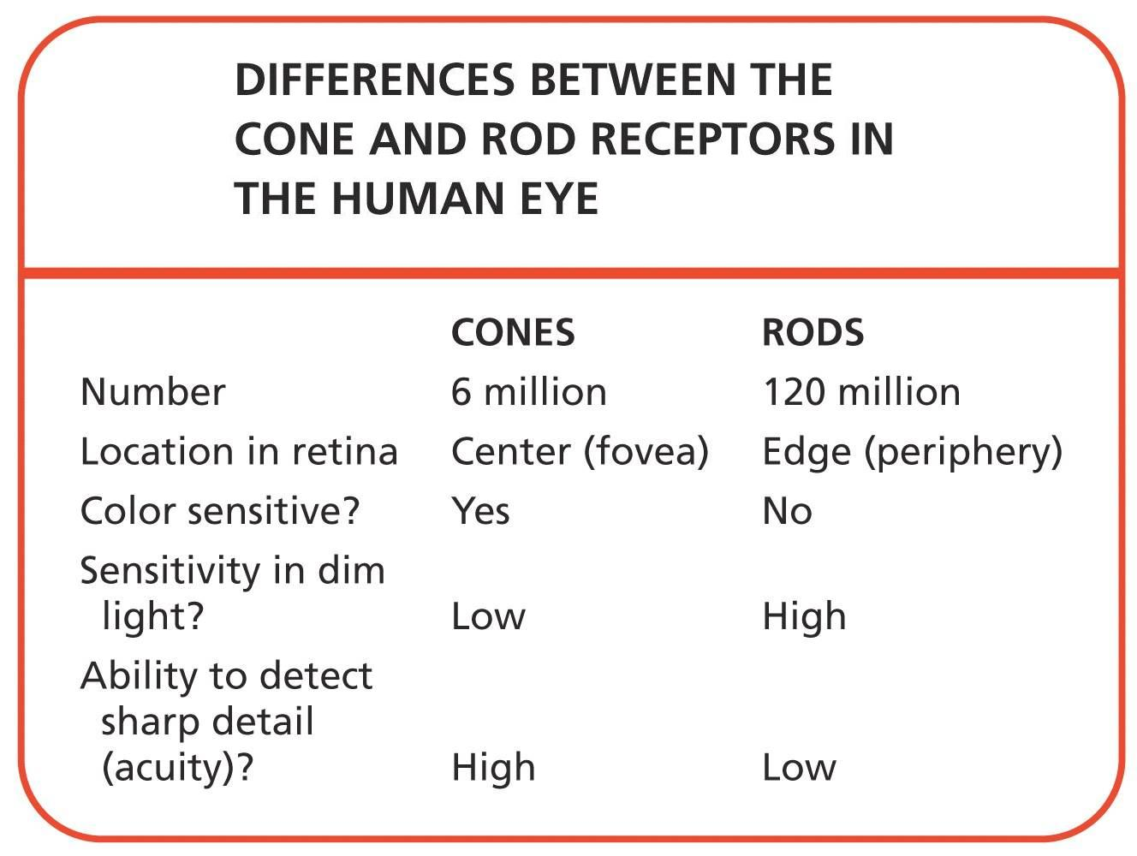

Slide 28
Fovea
The central focal point of the retina
The spot where vision is best (most detailed)

Slide 29
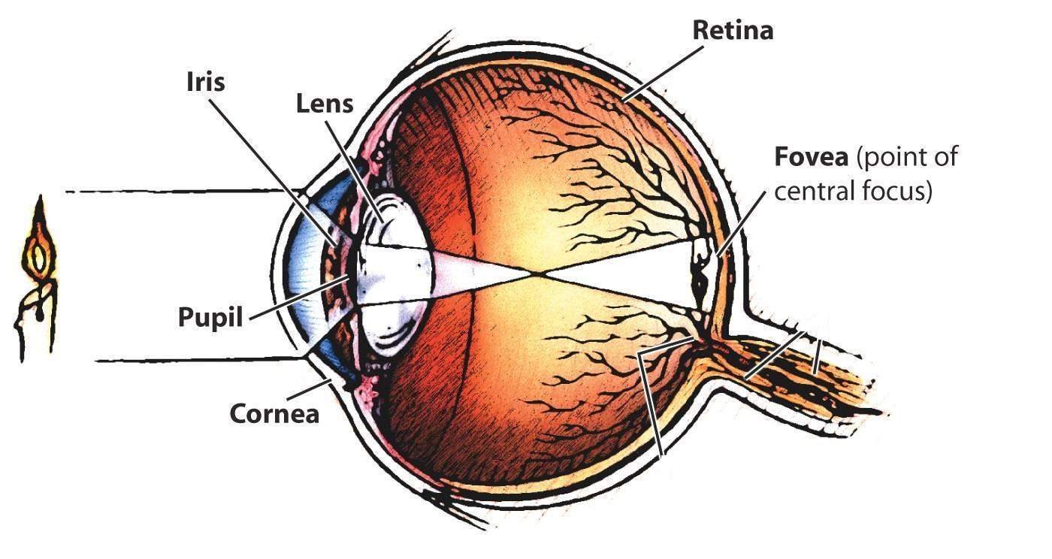
Parts of the Eye - Fovea

Slide 30
Bipolar Cells
Gather information from the rods and cones and pass it on to the ganglion cells
Cells that form the middle layer in the retina

Slide 31
Ganglion Cells
Pass the information from the bipolar cells through their axons
Together these cells form the optic nerve.
The top layer of the cells in the retina

Slide 32
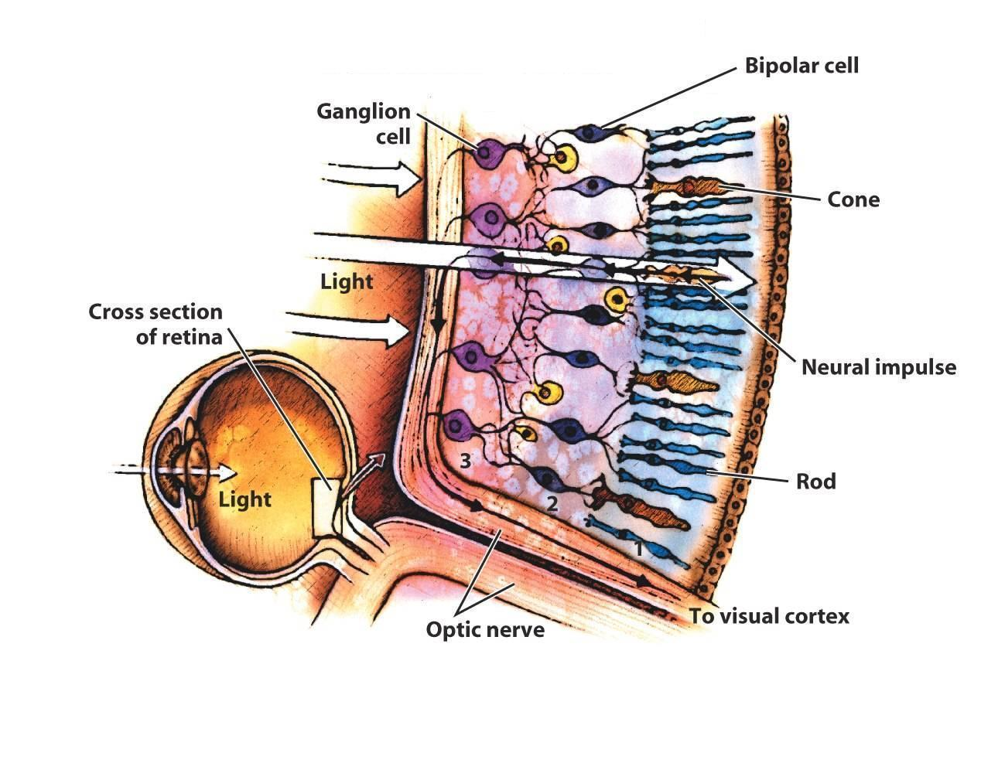
Visual Processing in the Retina

Slide 33
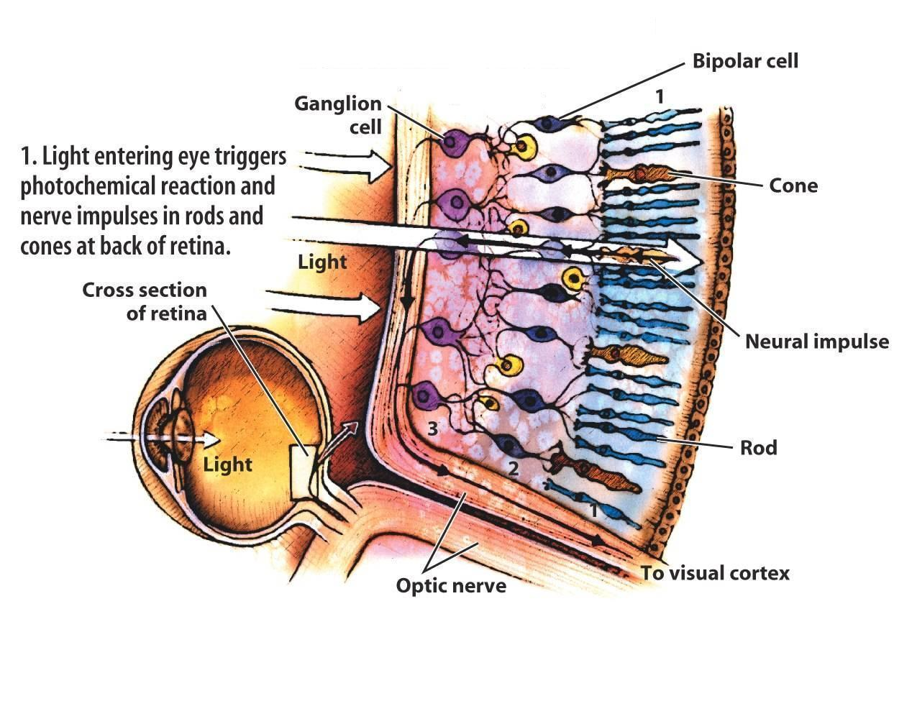
Visual Processing in the Retina

Slide 34
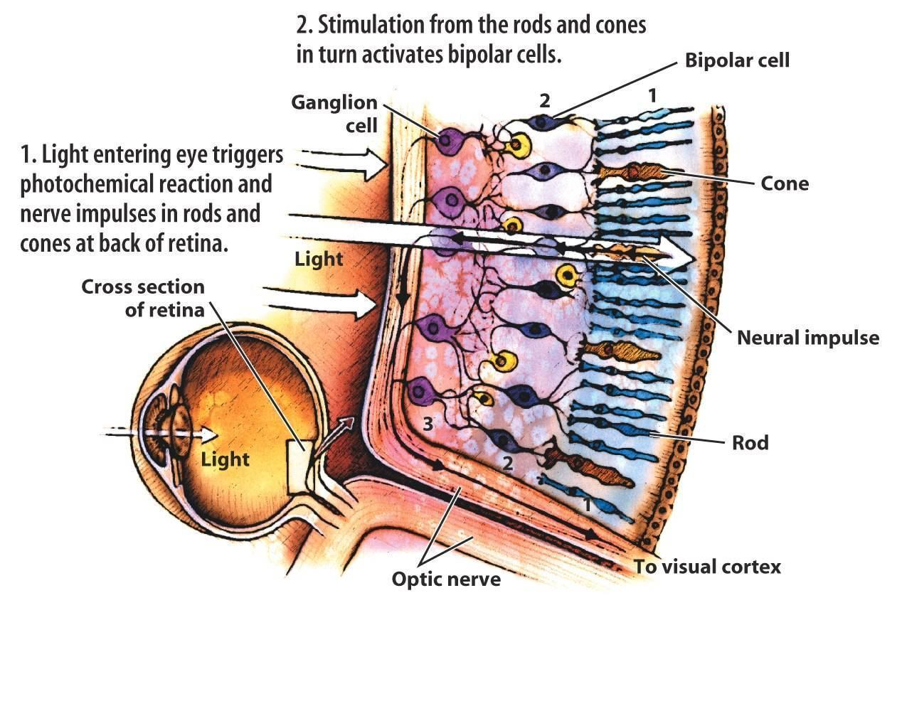
Visual Processing in the Retina

Slide 35
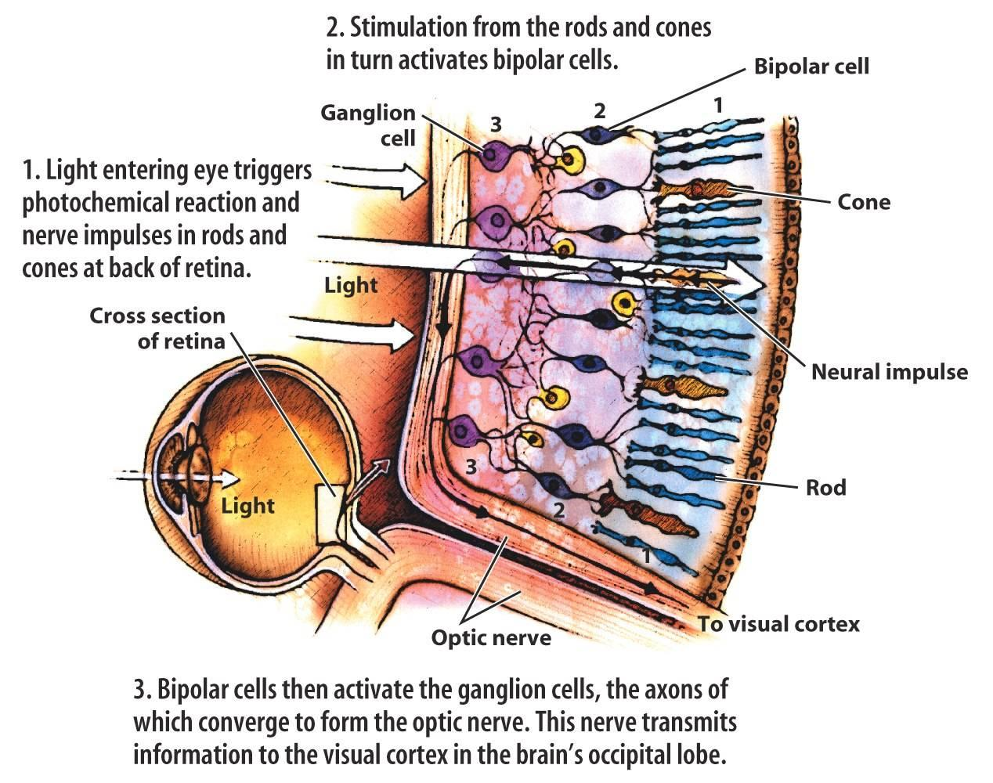
Visual Processing in the Retina

Slide 36
Optic Nerve
The nerve that carries visual information from the eye to the occipital lobes of the brain

Slide 37
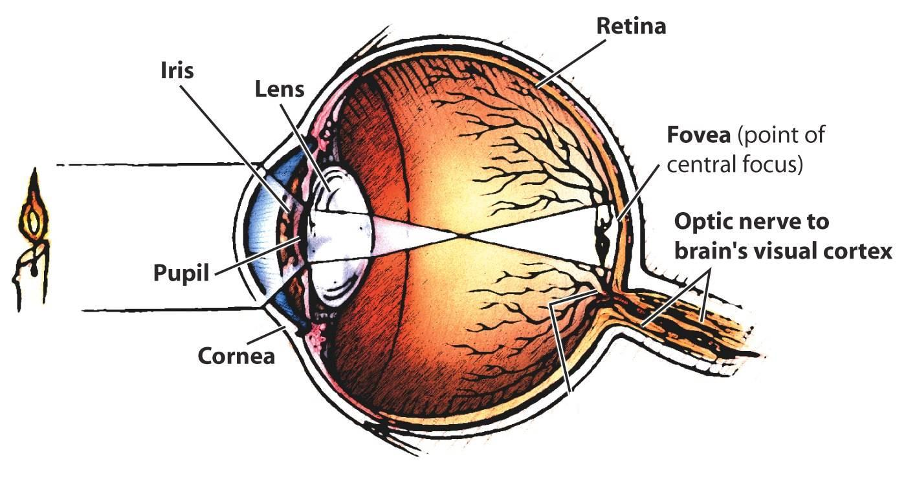
Parts of the Eye – Optic Nerve

Slide 38
Blind Spot
The point at which the optic nerve travels through the retina to exit the eye
There are no rods and cones at this point, so there is a small blind spot in vision.

Slide 39
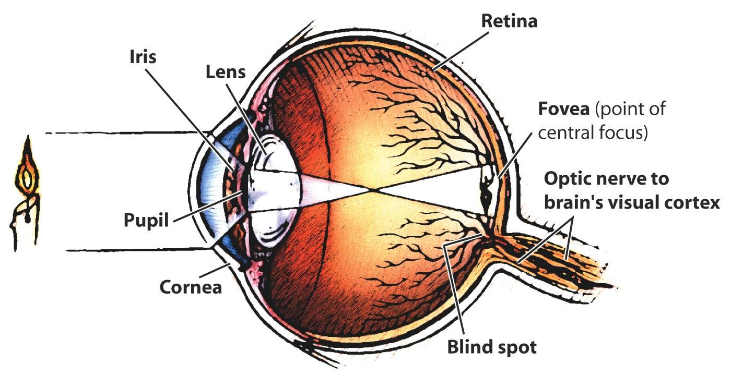
Parts of the Eye – Blind Spot

