Slide 2
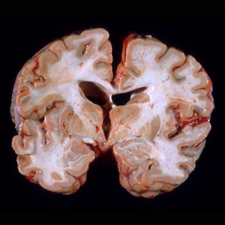
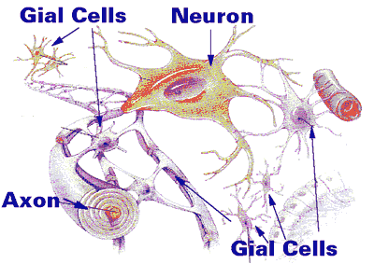
The Brain

Slide 3
Lower Brain
Known as the reptilian brain. Similar to most animals
Is basically the body’s autopilot system

Slide 4
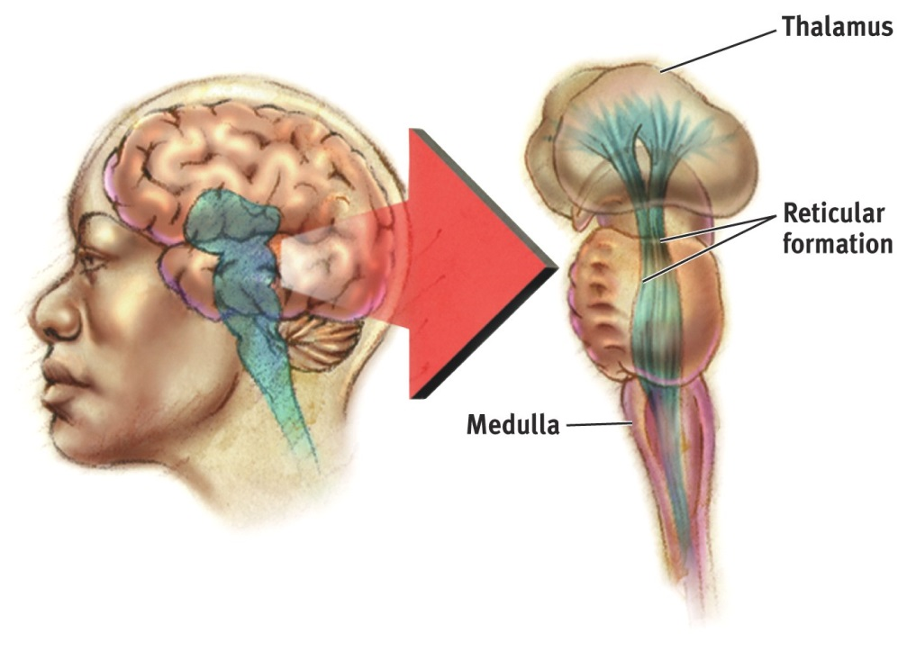
Lower Brain--Brain Stem
Medulla – where spinal cord meets the skull; controls heartbeat and breathing
Reticular formation– bundle of nerves running through the brainstem; controls arousal; filters irrelevant background information from senses; modulates pain.

Slide 5
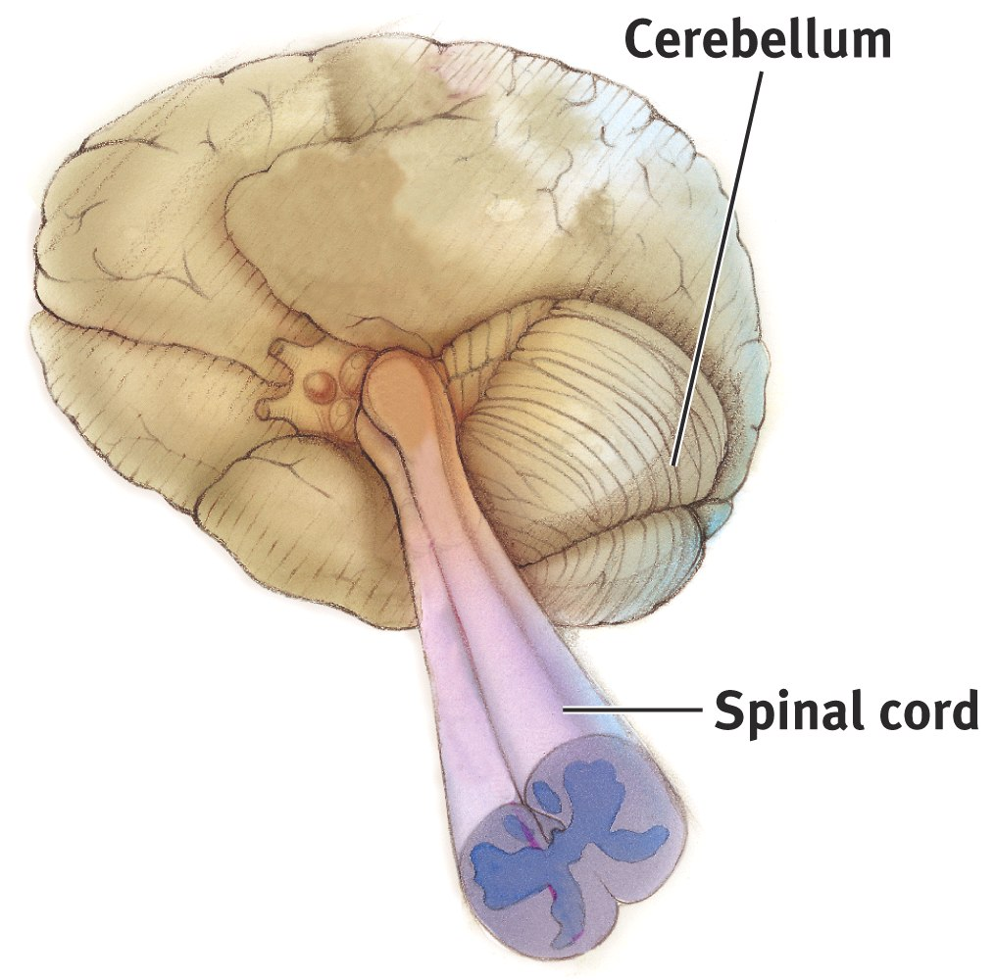
Cerebellum
Controls balance and coordination
In the rear of the head, behind the brainstem

Slide 6
Middle Brain

Slide 7
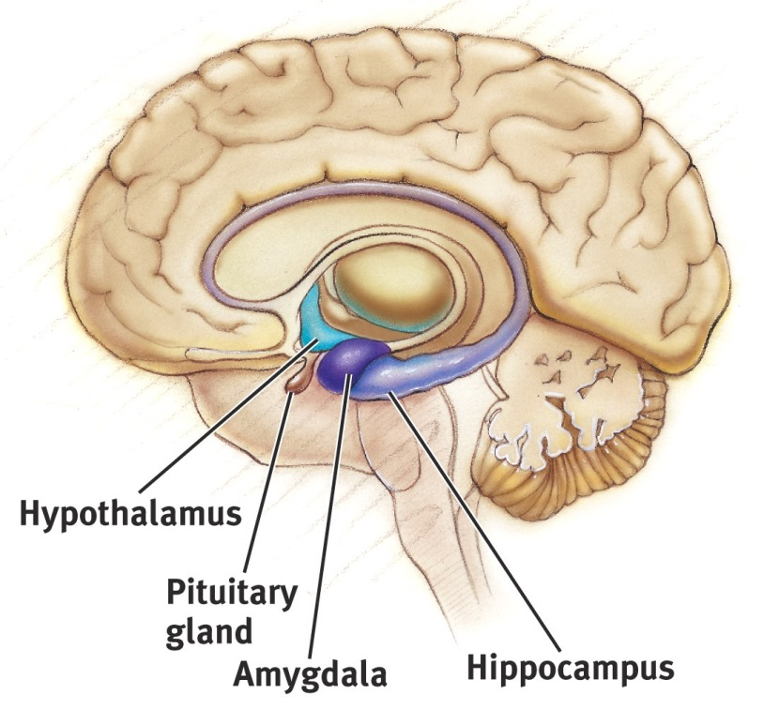
Thalamus
Thalamus
Pair of egg-shaped organs above the brainstem; receives information from the senses (EXCEPT FOR SMELL) and relays it to the rest of the brain.

Slide 8

Limbic System
  Amygdala – two almond shaped structures; influence fear and aggression (monkeys and cats)
  Hypothalamus – below the thalamus; regulates hunger, thirst, body temp, sex, fight-or-flight; triggers the pituitary (the “master gland”); reward center
  Hippocampus – behind the amygdala; memory

Slide 9
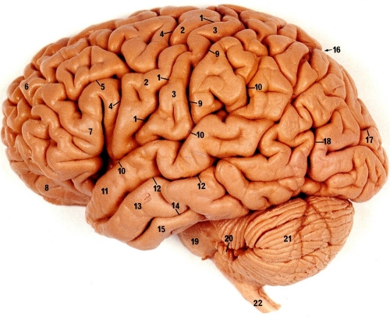
Cerebral Cortex
Controls information processing; wrinkled to increase surface area
Composed of 8 lobes (4 on each side)

Slide 10
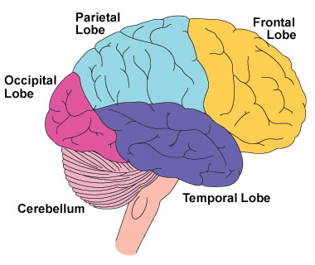
Frontal Lobes
  Located in the forehead region
  Includes the motor cortex (part of brain that controls voluntary movement)
    Association areas in this region – judgment, planning, processing new memories, Basically, higher order thinking.

Slide 11
Frontal Lobe Con’t
    Broca’s area (needed for forming words; located in left hemisphere only)
    Broca’s aphasia
Also contains Motor Cortex

Slide 12
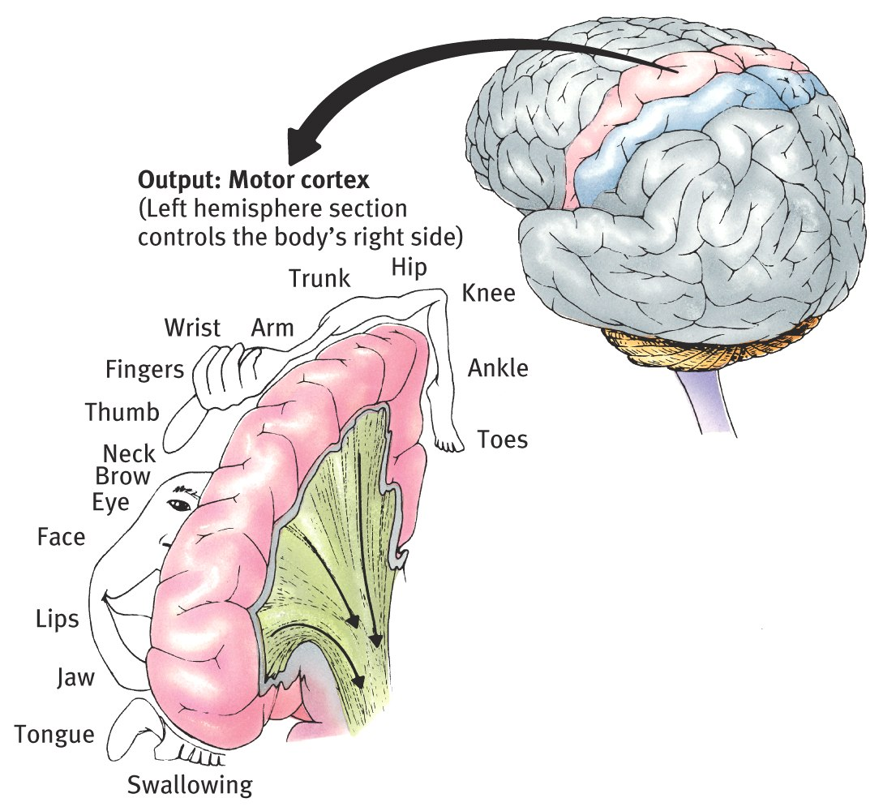

Slide 13
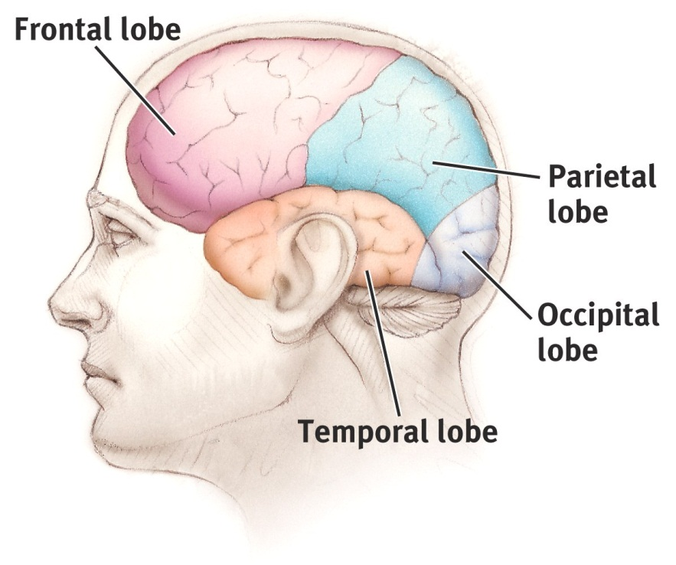
Parietal Lobes
  Located on the top and rear of head
  Contains the sensory cortex (part of brain that registers and processes tactile information (Sense of touch)
  Stores memories dealing with procedures/learned behaviors

Slide 14
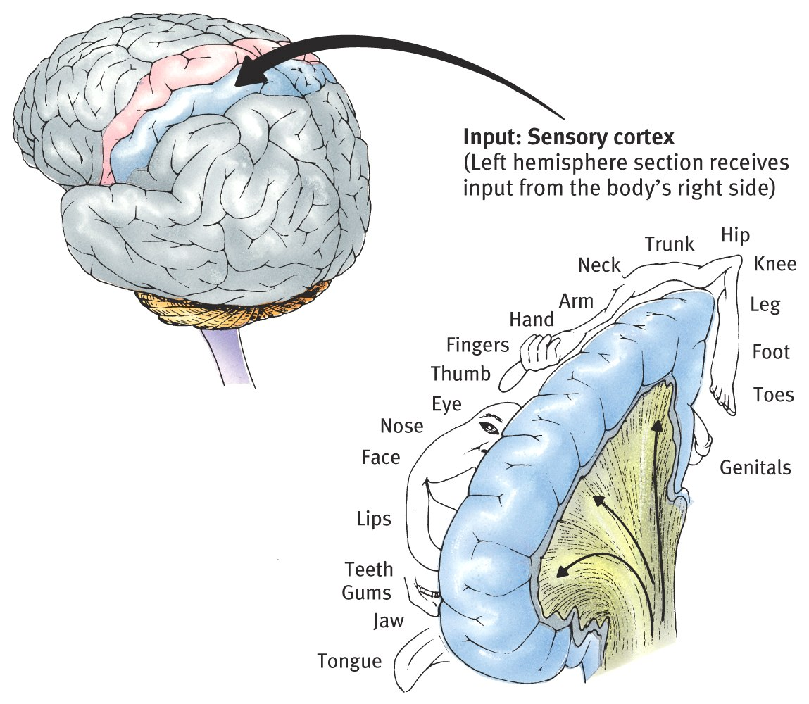

Slide 15

Occipital Lobes
  Located in the back of the head
  Contains the visual cortex
  Invovled in visual Memory

Slide 16
Temporal Lobes
  Located on the sides of head, above ears
  Receives and processes auditory information

Slide 17
Temporal Lobe continued
  Includes Wernicke’s area (left hemisphere only) - part of brain involved in understanding language
  Stores episodic memories

Slide 18
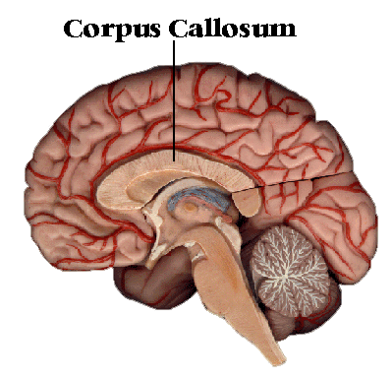
Corpus Callosum
bundle of nerves connecting the left and right hemispheres

