Slide 1
Thinking About Psychology: The Science of Mind and Behavior
Charles T. Blair-Broeker
Randal M. Ernst

Slide 2
Sensation and Perception
Chapter 04

Slide 3
Sensation
Module 09

Slide 4
Introduction
Module 9: Sensation

Slide 5
Sensation
The process by which our sensory systems (eyes, ears, and other sensory organs) and nervous system receive stimuli from the environment
A person’s awareness of the world

Slide 6
Perception
The process of organizing and interpreting sensory information

Slide 7
Bottom-Up Processing
Information processing that focuses on the raw material entering through the eyes, ears, and other organs of sensation

Slide 8
Top-Down Processing
Information processing that focuses on expectations and experiences in interpreting incoming sensory information

Slide 9
Thresholds
Module 9: Sensation

Slide 10
Threshold
An edge or a boundary

Slide 11
Absolute Threshold
The minimum difference that a person can detect between two stimuli 50% of the time
Also called just noticeable difference

Slide 12
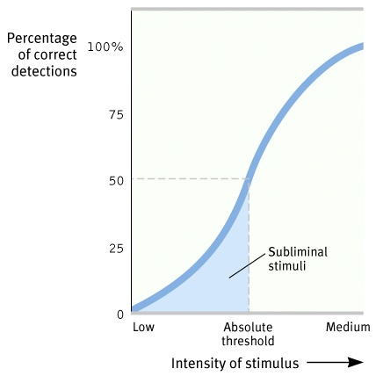
Absolute Threshold

Slide 13
Thresholds: Signal Detection Theory
Module 9: Sensation

Slide 14
Signal Detection Theory
Set of formulas and principles that predict when we will detect the presence of a faint stimulus (signal) amid background stimulation (noise)

Slide 15
Signal Detection Theory
Three kinds of variables
Stimulus variables
Environmental variables
Organismic variables

Slide 16
Sensory Adaptation
Module 9: Sensation

Slide 17
Sensory Adaptation
Diminished sensitivity as a result of constant stimulation
If a stimulus is constant and unchanging, eventually a person may fail to respond to it

Slide 18
Selective Attention
Module 9: Sensation

Slide 19
Selective Attention
Focusing conscious awareness on a particular stimulus to the exclusion of others
The ability to focus on one stimulus at a time
Allows a person to function in a world filled with many stimuli

